Slide 1
Unit-7 Java Server Pages(JSP)

Slide 2
Servlet
Servlets usually contain HTML code embedded in Java code.
Servlet=Java+HTML(i.e. HTML within java)
In addition, servlets do not separate the presentation logic from the business logic in an application.

Slide 3
Introduction to JSP
It can be thought of as an extension to servlet because it provides more functionality than servlet such as expression language, jstl etc.
JSP technology is used to create web application just like Servlet technology.
(JSP=HTML+Java i.e.java within HTML)
A JSP page is a text document that contains two types of text: static data, which can be expressed in any text-based format (such as HTML, WML- Wireless Markup Language, and XML), and JSP elements, which construct dynamic .
The jsp pages are easier to maintain than servlet because we can separate designing and development. It provides some additional features such as Expression Language, Custom Tag etc.

Slide 4
Why JSP is preffered over servlets?
JSP provides an easier way to code dynamic web pages.
JSP does not require additional files like, java class files, web.xml etc
Any change in the JSP code is handled by Web Container(Application server like tomcat), and doesn't require re-compilation.
JSP pages can be directly accessed, and web.xml mapping is not required like in servlets.

Slide 5
Advantage of JSP over Servlet
1) Extension to Servlet
2) Easy to maintain
3) Fast Development: No need to recompile and redeploy
4) Less code than Servlet

Slide 6
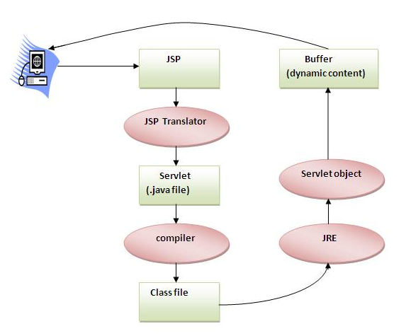
Processing of JSP

Slide 7
Life cycle of a JSP Page
The JSP pages follows these phases:
Translation of JSP Page
Compilation of JSP Page
Classloading (class file is loaded by the classloader)
Instantiation (Object of the Generated Servlet is created).
Initialization ( jspInit() method is invoked by the container).
Reqeust processing ( _jspService() method is invoked by the container).
Destroy ( jspDestroy() method is invoked by the container).

Slide 8
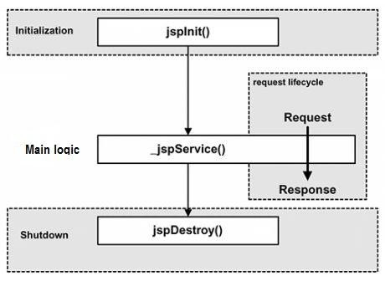
Life Cycle of JSP

Slide 9
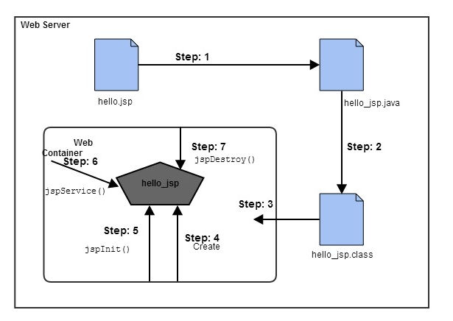

Slide 10
Step -1
JSP is not processed as such, they first gets converted into Servelts and then the corresponding servlet gets processed by Server.
whenever container receives request from client, it does translation only when servlet class is older than JSP page otherwsie it skips this phase.

Slide 11
Step-2:Then the container
compiles the corresponding servlet program
Loads the corresponding servlet class
Instantiates the servlet class
Calls the jspInit() method to initialize the servlet instance( Jsp container will do this job only when the instance of servlet file is not running or if it is older than the jsp file.)
public void jspInit()
{
//intialization code
}

Slide 12
Step:3
3) A new thread is then gets created, which invokes the_jspService() method, with a request (HttpServletRequest) and response (HttpServletRespnse) objects as parameters -shown below.
void _jspService( HttpServletRequest req, HttpServletResponse res) { //code goes here }[/code]

Slide 13
Step:4
4) Invokes the jspDestroy() method to destroy the instance of the servlet class. code will look like below –
public void jspDestory() { //code to remove the instances of servlet class }[/code]

Slide 14
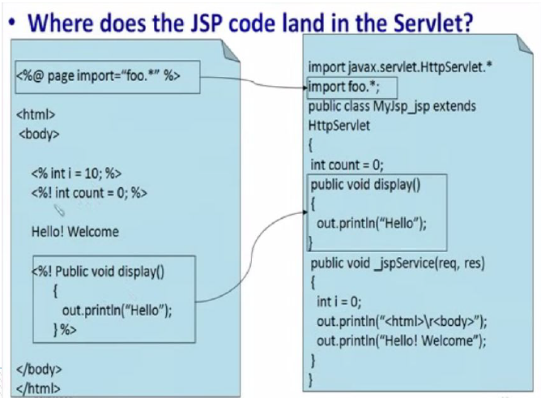

Slide 15
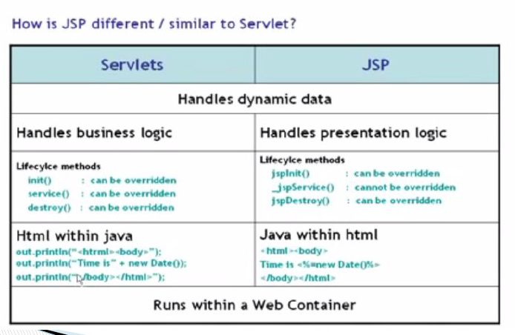

Slide 16
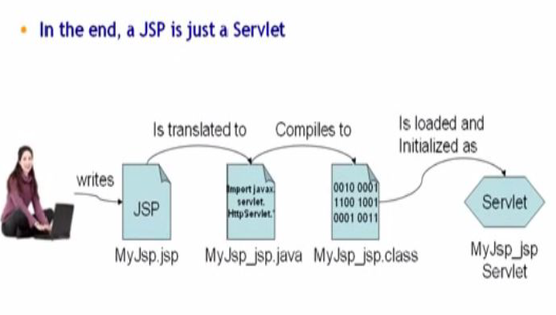

Slide 17
JSP Scripting element
JSP Scripting element are written inside <% %> tags. These code inside <% %> tags are processed by the JSP engine during translation of the JSP page. Any other text in the JSP page is considered as HTML code or plain text.
There are five different types of scripting elements.
Comment<%-- comment --%>
Directive<%@ directive %>
Declaration<%! declarations %>
Scriptlet<% scriplets %>
Expression<%= expression %>

Slide 18
Scriptlet Tag <% java code %>
<html>
<head>
<title>My First JSP Page</title>
</head>
<body> Page Count is
<% uout.println(++cont); %>
</body> </html>

Slide 19
Example
In this example, we will create a simple JSP page which retrieves the name of the user from the request parameter. The index.html page will get the username from the user.
index.html
<form method="post" action="welcome.jsp"> Name <input type="text" name="user" > <input type="submit" value="submit"> </form>

Slide 20
welcome.jsp
<html>
<title>Welcome Page</title>
<% String user = request.getParameter("user"); %>
<body> Hello, <% out.println(user); %> </body> </html>

Slide 21
Declaration Tag
We know that at the end a JSP page is translated into Servlet class. So when we declare a variable or method in JSP inside Declaration Tag, it means the declaration is made inside the Servlet class but outside the service(or any other) method. You can declare static member,instance variable and methods inside Declaration Tag.
Syntax of Declaration Tag
<%! declaration %>

Slide 22
Example of Declaration Tag
<html>
<head>
<title>My First JSP Page</title>
</head>
<%! int count = 0; %>
<body> Page Count is:
<% out.println(++count); %>
</body>
</html>

Slide 23
The above JSP page becomes this Servlet
public class hello_jsp extends HttpServlet
{ int count=0;
public void _jspService(HttpServletRequest request,HttpServletResponse response) throws IOException,ServletException
{
PrintWriter out = response.getWriter(); response.setContenType("text/html"); out.write("<html><body>");
out.write("Page count is:");
out.print(++count); out.write("</body></html>");
}
}

Slide 24
Expression Tag
Expression Tag is used to print out java language expression that is put between the tags. An expression tag can hold any java language expression that can be used as an argument to the out.print() method.
Syntax of Expression Tag
<%= JavaExpression %>
When the Container sees this
<%= (2*5) %>
It turns it into this:
out.print((2*5));

Slide 25
Example of Expression Tag
<html>
<head>
<title>My First JSP Page</title>
</head> <% int count = 0; %>
<body> Page Count is <%= ++count %> </body>
</html>

Slide 26
Directive Tag
Directive Tag gives special instruction to Web Container at the time of page translation. Directive tag are of three types: page,include and taglib.
<%@ page ... %>defines page dependent properties such as language, session, errorPage etc.
<%@ include ... %>defines file to be included.
<%@ taglib ... %>declares tag library used in the page

Slide 27
Page directive
You can place page directive anywhere in the JSP file, but it is good practice to make it as the first statement of the JSP page.
<%@ page attribute="value" %>
The Page directive defines a number of page dependent properties which communicates with the Web Container at the time of translation.
import attribute
language attribute
extends attribute
session attribute
isThreadSafe attribute
isErrorPage attribute
errorPage attribute
contentType attribute
autoFlush attribute
buffer attribute

Slide 28
1.Import Attribute
The import attribute defines the set of classes and packages that must be inported in servlet class definition.
For example
<%@ page import="java.util.Date" %> or <%@ page import="java.util.Date,java.net.*" %>

Slide 29
2)contentType
<html>
<body>
<%@ page contentType=text/html%>
Today is: <%= new java.util.Date() %>
</body>
</html>

Slide 30
3)info
<html>
<body>
<%@ page info=“Welcome to PU" %>
Today is: <%= new java.util.Date() %>
</body>
</html>
public String getServletInfo() {
return “Welcome to PU";
}

Slide 31
4)buffer
<html>
<body>
<%@ page buffer="16kb" %>
Today is: <%= new java.util.Date() %>
</body>
</html>

Slide 32
5)language
<%@ page language = "java" %>

Slide 33
6)isThreadSafe
<%@ page isThreadSafe="false" %>
public class SimplePage_jsp extends HttpJspBase
implements SingleThreadModel{
.......
}

Slide 34
7)errorPage
//index.jsp
<html>
<body>
<%@ page errorPage="myerrorpage.jsp" %>
<%= 100/0 %>
</body>
</html>

Slide 35
8)isErrorPage
//myerrorpage.jsp
<html>
<body>
<%@ page isErrorPage="true" %>
Sorry an exception occured!<br/>
The exception is: <%= exception %>
</body>
</html>

Slide 36
9)session
<%@ page session = "true" %>
10)The isScriptingEnabled Attribute
The isScriptingEnabled attribute determines if the scripting elements are allowed for use.
<%@ page isScriptingEnabled = "false" %>

Slide 37
11)autoFlush attribute
autoFlush attribute defines whether the buffered output is flushed automatically. The default value is "true".
12)isELIgnored
isELIgnored attribute gives you the ability to disable the evaluation of Expression Language (EL) expressions which has been introduced in JSP 2.0.
<%@ page isELIgnored = "false" %>

Slide 38
Implicit Objects in JSP
JSP provide access to some implicit object which represent some commonly used objects for servlets that JSP page developers might need to use. For example you can retrieve HTML form parameter data by using request variable, which represent the HttpServletRequest object.

Slide 39
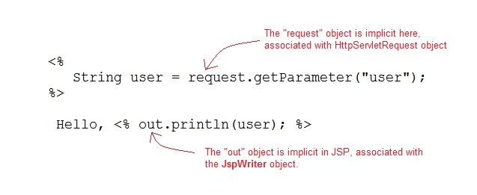

Slide 40
Implicit Object Description
request :The HttpServletRequest object associated with the request.
Response :The HttpServletRequest object associated with the response that is sent back to the browser.
Out :The JspWriter object associated with the output stream of the response.
Session :The HttpSession object associated with the session for the given user of request.
Application :The ServletContext object for the web application.
Config:The ServletConfig object associated with the servlet for current JSP page.
pageContext :The PageContext object that encapsulates the enviroment of a single request for this current JSP page
Page :The page variable is equivalent to this variable of Java programming language.
exception :The exception object represents the Throwable object that was thrown by some other JSP page.

Slide 41
Include Directive
The include directive tells the Web Container to copy everything in the included file and paste it into current JSP file. Syntax of include directive.
<%@ include file="filename.jsp" %>

Slide 42
Example of include directive
welcome.jsp
<html>
<head>
<title>Welcome Page</title>
</head>
<body> <%@ include file="header.jsp" %> Welcome, User </body>
</html>
header.jsp
<html> <body> <img src="header.jpg“
alt="This is Header image" / > </body> </html>

Slide 43
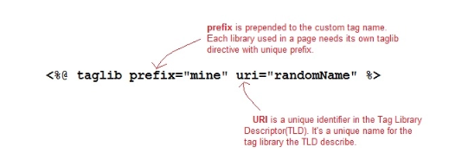
Taglib Directive
The taglib directive is used to define tag library that the current JSP page uses. A JSP page might include several tag library. Syntax of taglib directive:

Slide 44
Example of Taglib Directive
In this example, we are using a tag userName. To use this tag we must specify some information to the Web Container using Taglib Directive.
<html> <head> <title>Welcome Page</title> </head>
<%@ taglib prefix="mine" uri="myTags" %> <body> Welcome, <mine:userName / > </body> </html>

Slide 45
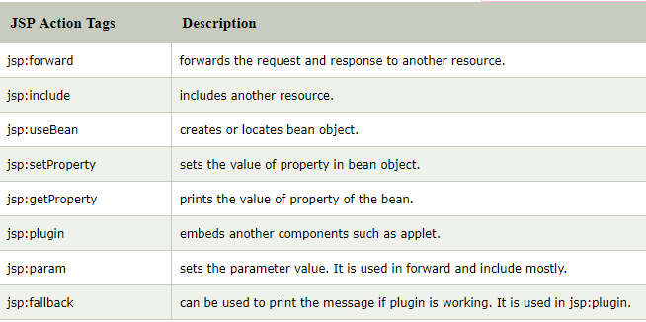
JSP Action Tags
used to control the flow between pages and to use Java Bean.

Slide 46
jsp:forward action tag
Syntax of jsp:forward action tag without parameter
<jsp:forward page="relativeURL | <%= expression %>" />
Syntax of jsp:forward action tag with parameter
<jsp:forward page="relativeURL | <%= expression %>“> <jsp:param name="parametername" value="parametervalue | <%=expression%>" />
</jsp:forward>

Slide 47
Example of jsp:forward action tag without parameter
<html>
<body>
<h2>this is index page</h2>
<jsp:forward page="printdate.jsp" />
</body>
</html>

Slide 48
<html>
<body>
<% out.print("Today is:"+java.util.Calendar.getInstance().getTime()); %>
</body>
</html>

Slide 49
Example of jsp:forward action tag with parameter
<html>
<body>
<h2>this is index page</h2>
<jsp:forward page="printdate.jsp" >
<jsp:param name="name" value=“PU" />
</jsp:forward>
</body>
</html>

Slide 50
<html>
<body>
<% out.print("Today is:"+java.util.Calendar.getInstance().getTime()); %>
<%= request.getParameter("name") %>
</body>
</html>

Slide 51
jsp:include action tag
Syntax of jsp:include action tag without parameter
<jsp:include page="relativeURL | <%= expression %>" />
Syntax of jsp:include action tag with parameter
<jsp:include page="relativeURL | <%= expression %>">
<jsp:param name="parametername" value="parametervalue | <%=expression%>" />
</jsp:include>

Slide 52
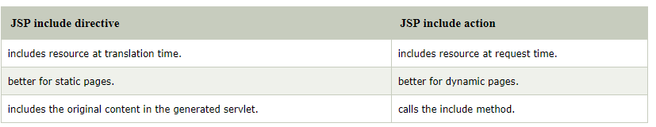
Difference between jsp include directive and include action

Slide 53
Example of jsp:include action tag without parameter
<h2>this is index page</h2>
<jsp:include page="printdate.jsp" />
<h2>end section of index page</h2>
<% out.print("Today is:"+java.util.Calendar.getInstance().getTime()); %>

Slide 54
Java Bean
A Java Bean is a java class that should follow following conventions:
It should have a no-arg constructor.
It should be Serializable.
It should provide methods to set and get the values of the properties, known as getter and setter methods.

Slide 55
Why use Java Bean?
it is a reusable software component.
A bean encapsulates many objects into one object, so we can access this object from multiple places.
Moreover, it provides the easy maintenance.

Slide 56
package mypack;
public class Employee implements java.io.Serializable{
private int id;
private String name;
public Employee(){}
public void setId(int id){this.id=id;}
public int getId(){return id;}
public void setName(String name){this.name=name;}
public String getName(){return name;}
}

Slide 57
to access the java bean
package mypack;
public class Test{
public static void main(String args[]){
Employee e=new Employee();//object is created
e.setName("Arjun");//setting value to the object
System.out.println(e.getName());
}}

Slide 58
jsp:useBean action tag
<jsp:useBean id= "instanceName"
scope= "page | request | session | application"
class= "packageName.className"
type= "packageName.className"
beanName="packageName.className |
<%= expression >" >
</jsp:useBean>

Slide 59
package com.pu;
public class Calculator{
public int cube(int n){return n*n*n;}
}
<jsp:useBean id="obj" class="com.pu.Calculator"/>
<%
int m=obj.cube(5);
out.print("cube of 5 is "+m);
%>

Slide 60
Syntax of jsp:setProperty action tag
<jsp:setProperty name="instanceOfBean" property= "*" |
property="propertyName" param="parameterName" |
property="propertyName" value="{ string | <%= expression %>}"
/>
2. <jsp:setProperty name="bean" property="*" />
3.<jsp:setProperty name="bean" property="username" />
4. <jsp:setProperty name="bean" property="username" value="Kumar" />

Slide 61
jsp:getProperty action tag
jsp:getProperty name="instanceOfBean" property="propertyName" />

Slide 62
<form action="process.jsp" method="post">
Name:<input type="text" name="name"><br>
Password:<input type="password" name="password"><br>
Email:<input type="text" name="email"><br>
<input type="submit" value="register">
</form>

Slide 63
<jsp:useBean id="u" class="org.sssit.User"></jsp:useBean>
<jsp:setProperty property="*" name="u"/>
Record:<br>
<jsp:getProperty property="name" name="u"/><br>
<jsp:getProperty property="password" name="u"/><br>
<jsp:getProperty property="email" name="u" /><br>

Slide 64
package org.sssit;
public class User {
private String name,password,email;
//setters and getters
}

Slide 65
Displaying applet in JSP (jsp:plugin action tag)
<jsp:plugin type= "applet | bean" code= "nameOfClassFile"
codebase= "directoryNameOfClassFile"
</jsp:plugin>

Slide 66
<html>
<head>
<meta http-equiv="Content-Type" content="text/html; charset=UTF-8">
<title>Mouse Drag</title>
</head>
<body bgcolor="khaki">
<h1>Mouse Drag Example</h1>
<jsp:plugin align="middle" height="500" width="500"
type="applet" code="MouseDrag.class" name="clock" codebase="."/>
</body>
</html>

